Slide 1
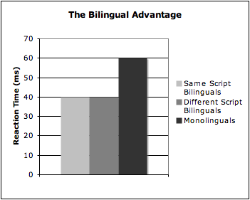
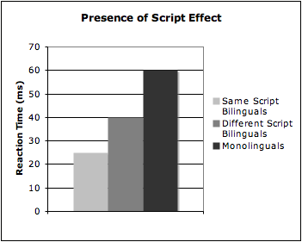
The Effect of Script on Bilingual Language Acquisition in
Novel Language Vocabulary Learning
Emma Hance
Advisor: Dr. Janet G. van Hell
Introduction:
In learning a new language, experienced foreign language learners not only learn more novel words than inexperienced foreign language learners (monolinguals), but are also faster at retrieving the learned words from their memory (e.g., van Hell & Mahn, 1997)
The bilingual advantage in novel word learning has been shown in all different types of bilinguals, from same script bilinguals to different script bilinguals.
Kaushanskaya and Marian (2009) found that the foreign language learning abilities of same script bilinguals do not significantly differ from those of different script bilinguals.
Both groups of bilinguals were tested in English
In the early stages of foreign language learning, lexical processing attaches words in the L2 (or L3) to the translation in the L1
When testing the effect of script on bilingual language acquisition, the scripts of the learners’ L1 must vary.
Present Study:
Compare and contrast the abilities of same script bilinguals (Swedish-English) with different script bilinguals (Mandarin-English) when learning a third language, Malay.
Materials:
80 novel Malay words and their translations. Each translation will have 4 foils. Foils will be compiled so that, for each translation, one foil is phonologically similar to the correct choice in the L1, one is semantically related to the correct choice, one is the translation of another Malay word in the learned set, and one is completely unrelated to the correct choice.
Participants:
20 same script bilinguals (Swedish-English)
20 different script bilinguals (Mandarin-English)
20 English monolinguals
Hypotheses:
We predict that both the same script bilinguals and the different script bilinguals would outperform the monolingual group; however, there would be differences between the performances of the two bilingual groups.
2. Malay, like Swedish and English, utilizes the Latin script, therefore we hypothesize that, having already mastered two Latin script languages, the same script bilinguals would have an advantage over the different script bilinguals.
Research Question:
Do the scripts of a bilingual’s languages have an affect on the bilingual’s ability to acquire a third language?
Method:
Learning Phase:
Participants will hear a Malay word pronounced twice over headphones while they are presented with the Malay word and its translation in the participant’s L1 on the screen. Participants will be asked to repeat each Malay word out loud after it is pronounced over the headphones. During this phase, participants will be presented with 80 novel words, each of which will be presented twice.
Test Phase:
The test phase will consist of two smaller test phases, one administered immediately following the learning phase and one after a 1-week delay. Each test consists of a recall and a recognition task. During the recall task, participants will hear the Malay word and be asked to produce the translation in their L1. In the recognition task, participants will hear the Malay word and be asked to select the correct translation from five options on the screen (the correct choice and four foils).
References:
Hoshino, N., & Kroll, J. (2008). Cognate effects in picture naming: Does cross-language activation survive a change of script?. Cognition, 106(1), 501-511. Retrieved November 14, 2011, http://www.sciencedirect.com/science/article/pii/S0010027707000431
Kaushanskaya, M., & Marian, V. (2009). The bilingual advantage in novel word learning. Psychonomic Bulletin & Review, 16(4), 705-710.
Van Hell, J., & Mahn, A. (1997). "Keyword mnemonics versus rote rehearsal: Learning concrete and abstract foreign words by experienced and inexperienced learners." Language Learning 47(3), 507-546. Web. Retrieved November 13, 2011.

